Slide 1
Relational Database Design
The goodness of relational schemas are checked in two levels.
The logic level – how users interpret the relational schemas and the meaning of their attributes. If the schema is good at this level then users enable to understand clearly the meaning of data in the relation. Therefore, they can formulate their queries.
The implementation level – how the tuples in a base relation are store and update.

Slide 2
Informal Design Guidelines for relational Schemas
The following are the informal guidelines for designing a database:
-Semantics of the relation attributes should be clear
-Reducing the redundant values in tuples
-Reducing the null values in tuples
-Disallowing the possibility of generating spurious tuples

Slide 3
Semantic of the Relation Attributes
The meaning of semantic, specifies how to interpret the attribute values stored in a tuple of the relation or in other words, how the attribute values in a tuple relate to one another.
Considered the following relational schemas
EMPLOYEE
FK
ENAME | ENO | DOB | ADDRESS | DNUMBER
DEPARTMENT
DNAME | DNUMBER | DMGRENO

Slide 4
Guideline - 1
Design a relation schema so that it is easy to explain its meaning. Do not combine attributes from multiple entity types and relationship types into single relation

Slide 5
Redundant Information and Update Anomalies
EMP_DEPT
ENAME | ENO | DOB | ADDRESS | DNUMBER | DNAME | DMGRENO
In the above relation attributes values (DNAME, DMGRNO) are repeated for each employ
Who works for a particular department. So there is wastage of space.
Another serious problem is update anomalies.
Update anomalies are :
Insertion anomalies: It is difficult to insert a new department that has no employee yet.
This because ENO is the primary key which can not be null.
Deletion anomalies: We delete from an employee tuple that happens to represent the last Employee working for a particular department, the information concerning department is lost
Modification Anomalies:

Slide 6
Guideline -2
Design the base relation schema so that no insertion, deletion or modification anomalies are present in the relations.

Slide 7
Null Values in Tuples
If we group many attributes together into a relation and many of the attributes do not apple to all tuples in the relation, we end up with nulls in those tuples.
Following are the problems with null values:
- This can waste space at the storage level
- It may also lead to the problems with understanding the meaning of the attributes and with the specifying JOIN operations at the logic level.
- Aggregate operations ( COUNT, SUM) on null values.

Slide 8
Guideline - 3
As far as possible, avoid placing attributes in a base relation whose values may frequently be null.

Slide 9
Generation of Spurious Tuples
Consider the following relations:
EMP_PROJ (ENO, PNUMBER, HOURS, ENAME, PNAME, PLOCATION)
EMP_LOC (ENAME, PLOCATION)
EMP_PROJ1 (ENO, PNUMBER, HOURS, PNAME, PLOCATION)
If we attempt a NATURAL JOIN operation on EMP_LOC and EMP_PROJ1, the result produces many more tuples than the original set of EMP_PROJ. These additional tuples are called spurious tuples because they represent wrong information.

Slide 10
Guideline - 4
Design relation schemas so that they can be joined with equality condition on attributes that are either primary keys or foreign keys in a way that guarantees that no spurious tuples are generated.

Slide 11
Functional Dependency
A functional dependency is a constraint between two sets of attributes from the database.
Let X and Y be the two sets of attributes of a relational schema (R).
The constraint is that for any two tuples t1 and t2 in r( R ) that have t1[X] = t2[X], they must have t1[Y] = t2[Y]. This means that the values of Y component of a tuple in r( R ) depend on or are determined by the values of X component. So Y is functionally dependent on X.
The functional dependency is denoted as X → Y.

Slide 12
Closure of a set of Functional Dependencies
Consider the relational schema R = (A, B, C, G, H, I) and the set of functional dependencies F{ A → B, A → C, CG → H, CG → I, B→ H}.
Suppose t1[A] = t2[A], ---------- (1)
since A → B, so t1[B] = t2[B] ---------- (2)
Again B→ H t1[H] = t2[H] -------- (3)
From 1 and 3 we can say A → H from the definition of FD.
The closure of F is the set of functional dependencies that can be deduced from the FD’s of F and it is denoted by F⁺
F⁺ can be computed from the definition of FD but this process would be lengthy and difficult.
There six inference rules for calculating F⁺

Slide 13
Inference Rules
Reflexive rule: If X is a set of attributes and Y is a subset of X , then X→ Y holds
Augmentation rule: If X→ Y holds and Z is a set of attributes, XZ→ YZ holds.
Transitive Rule: If X→ Y holds and Y → Z holds, then X → Z holds.
These three rules are called Armstrong’s axioms.
In addition, of this rules, there are some additional rules that can be proved from Armstrong’s rules.
Union rule: If X→ Y holds and X → Z holds, then X → YZ holds.
Decomposition rule: If X → YZ holds, then X→ Y holds and X → Z holds.
Pseudo transitive rule: If X→ Y holds and YZ → W, then XZ → W holds.

Slide 14
Equivalence of Sets of Functional Dependencies
Two sets of functional dependencies E and F are equivalent if E⁺ = F⁺. Hence, equivalence means that every FD in E can be inferred from F, and every FD in F can be inferred from E.

Slide 15
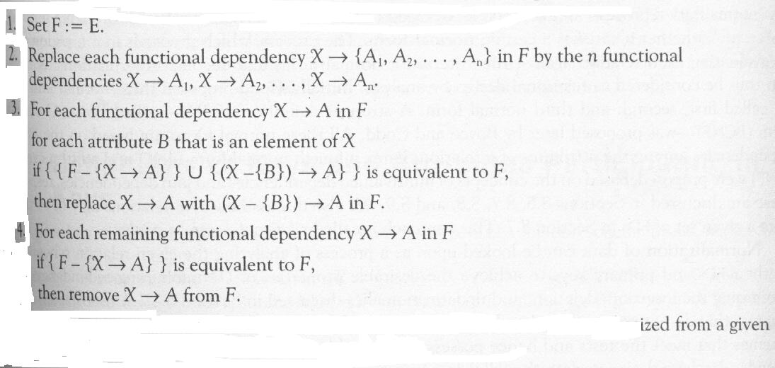
Minimal Sets of Functional Dependencies
A set of functional dependencies F to be minimal if it satisfies following conditions:
- Every dependency in F has a single attribute for its right-hand side.
- We can not replace any dependency X → A in F with a dependency Y → A, where Y is a proper sub-set of X and still have a set of dependencies that is equivalent to F.
- We can not remove any dependency from F and still have a set of dependencies that is equivalent to F.
-Algorithm: Finding a minimal cover F for a set of functional dependencies E

Slide 16
Normalization of Relations
At first, the normalization process was proposed by Codd in 1972. This process takes a relation, performs a series of tests to certify whether it satisfies a certain normal form.
Initially, Codd proposed three normal form. They are first (1NF), second (2NF) and third (3NF) normal form. A stronger definition of of 3NF is called Boyce-Codd normal form (BCNF). All these normal forms are based on the functional dependencies.
Latter, a fourth normal form (4NF) and a fifth normal form (5NF) were proposed.
Although several higher normal forms have been defined, such as 4NF and 5NF, the practical utility of these normal forms becomes questionable when the constraints on which they are based are hard to understand or detect by the database designers and users who must discover these constraints.
Thus, database design as practiced in industry today pays attention to normalization only up to 3NF.

Slide 17
Prime Attribute and Non-prime attribute
Prime attribute: An attribute of a relation schema R is called prime attribute of R if it is a member of some candidate key of R.
Non-prime attribute: An attribute is called non-prime attribute if it is not a prime attribute – that is, if it is not a member of any candidate key.

Slide 18
Normal Form Based on Primary key
First Normal Form: It states that the domain of an attribute must include only atomic (simple, indivisible) values and that the value of any attribute in a tuple must be a single value from the domain of that attribute.
Consider the schema of DEPARTMENT of a company database
DEPARTMENT(DNO, DNAME, DMGRNO, DLOCATION) we have considered earlier that a department has more than one locations,
so the DEPARTMENT relation is not in 1NF.
To achieve first normal form for such relation, remove the attribute DLOCATION that violates 1NF and place it in a separate relation DEPT_LOCTIONS along with primary key DNO of DEPARTMENT.
The primary key of DEPT_LOCATIONS is the combination of {DNO, DLOCATION}

Slide 19
Second Normal Form (2NF)
Second normal form is based on the concept of full functional dependency. A functional dependency X→ Y is a full functional dependency if removal of any attribute A from X means that the dependency does not hold any more.
A relation schema R is in 2NF if it is in 1NR and every non-prime attribute A in R is fully functionally dependent on the primary key of R.
Consider the following relation
EMP_PROJ(ENO, PNUMBER, HOURS, ENAME, PNAME,PLOCATION)
FD1 ENO → ENAME, FD2 (ENO, PNUMBER) → HOURS and
FD3 PNUMBER → (PNAME, PLOCATION)
The relation EMP_PROJ is in 1NF but not in 2NF because of FD1 and FD3.
To achieve second normal form for such relation, decompose the relation as follows:
EP1 (ENO, PNUMBER, HOURS), EP2(ENO, ENAME) EP3(PNUMDER, PNAME,
PLOCATION)

Slide 20
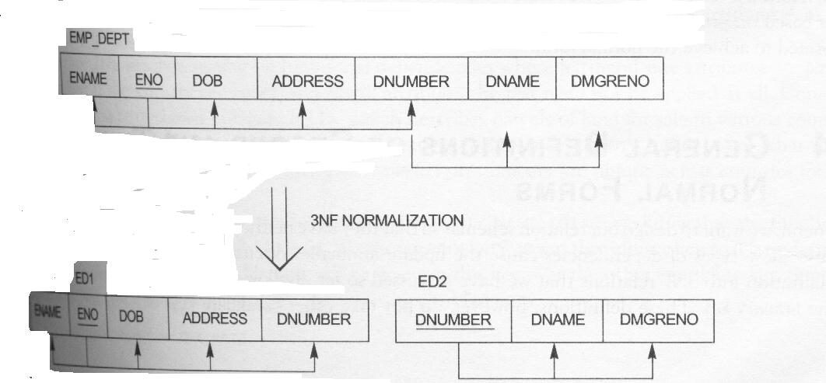
Third Normal Form (3NF)
Third normal form is based on the concept of transitive dependency.
Definition: According to Codd’s, a relation schema R is in 3NF if it satisfied 2NF and no nonprime attribute of R is transitively dependent on the primary key.
The Schema EMP_DEPT is not in 3NF because of the transitive dependency of DMGRENO and DNAME on ENO.

Slide 21

General Definition of 2NF and 3NF
A relation schema R is in 2NF if every nonprime attribute A in R is not partially dependent on any key of R.
The test for 2NF involves testing for functional dependencies whose left side attributes are part of the primary key. If the primary key contains a single attribute, the test is need not applied at all.
A relation schema R is in third normal form if, wherever a nontrivial functional dependency X →A holds in R, either (I) X is a superkey of R, or (ii) A is a prime attribute of R.

Slide 22
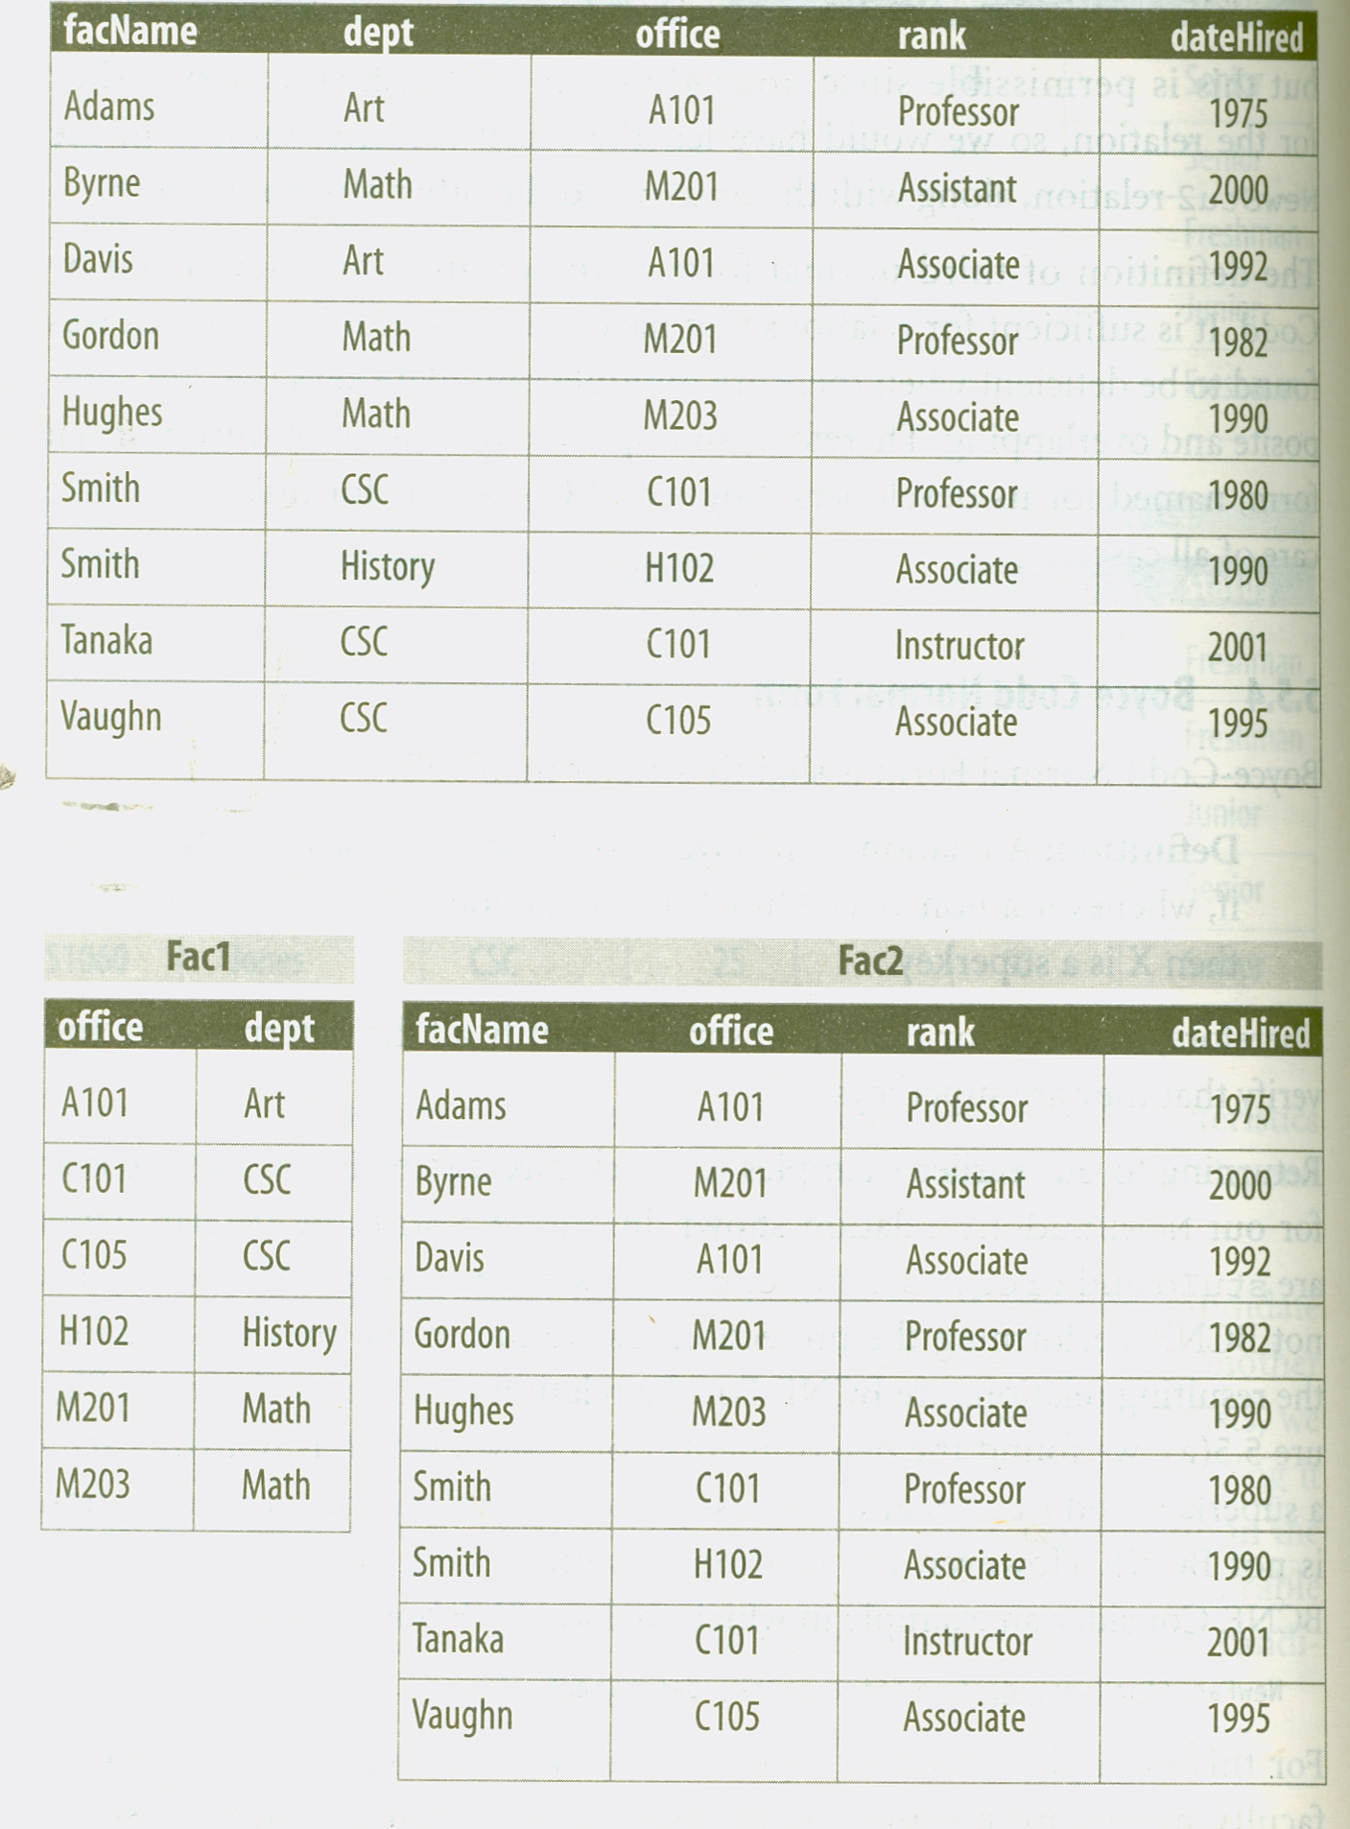
Example of BCNF

Slide 23
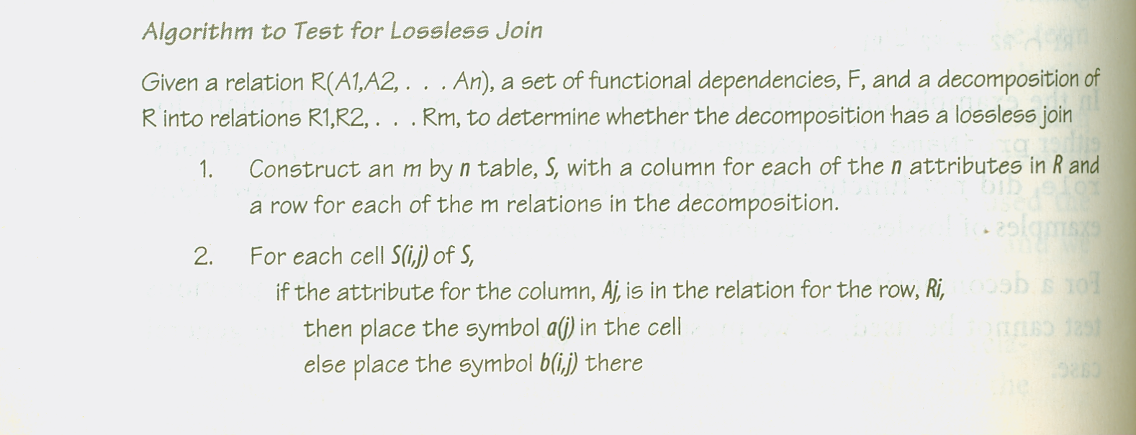
Lossless Decomposition

Slide 24
